Slide 1
Welcome to CS 109ACE!
Ethan Hersch

Slide 2



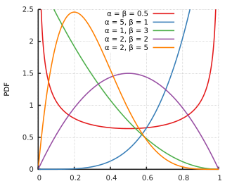
Hi, I’m Ethan!
Deep learning, AI, statistics

Slide 3
Agenda
Logistics + intros
Lecture review - Counting
  Practice!
Lecture review - Intro Probability
  More practice!
Lecture review - Bayes Theorem
  Practice (again)!
+ your questions

Slide 4
Let’s get to know each other!
Name, year, major
Where are you from?
1 thing you miss the most about the summer
1 thing you’re most excited about this quarter

Slide 5
First some logistics…
We will meet every Wednesday
Attend 7/9 sessions to receive credit for the quarter
Join the slack! https://cs109ace.slack.com/archives/C0C4PGF59FX
  Can reach out whenever
  Use as a resource to ask general questions about the course
Fill out OH availability form! https://www.when2meet.com/?38886965-Tb3sy
1:1 meetings with me at least once in the quarter (reach out if other concerns)

Slide 6
One other form 😵‍💫
Intro form, other information – please complete before next week!
https://docs.google.com/forms/d/e/1FAIpQLSe1mAsUZwbRjNByQ0WeNJBttXR4dU4jgqT3zDxu_NWCYBJtMQ/viewform?usp=publish-editor
(I’ll send in the Slack, along with all the other forms)

Slide 7
ACE Mission
“The mission of ACE is to provide our students, particularly those from under-resourced and/or minoritized backgrounds, with the opportunities and support to succeed in their course and in their major. ACE sections, instruction, and the ACE Course Assistants (CA’s) are intentional about fostering environments based on equity, purposeful engagement, and inclusive teaching practices.”

Slide 8
Expectations from ACE
Attend lectures for CS 109
(Remember that ACE is a supplementary course and not a replacement for the course lectures)
In 109, ACE does not replace regular section!
Attend and be engaged in section
Make the most out of their time in ACE!

Slide 9
Expectations
Ask questions! I’m not here to grade you, lecture you, etc. This course is meant for support.
Tell me if something isn’t working: this class will be tuned to your preferences throughout this quarter (surveys, exit tickets, check-ins)
Make mistakes. I’ll make mistakes this quarter, and we all will.

Slide 10
My Teaching Philosophy
Nobody starts an expert, and nothing replaces hard work.
This all comes from making mistakes and not being afraid to try new problems.
We will try a lot of new problems together and encourage mistakes!

Slide 11
Why CS 109?
First, we will do combinatorics:
A surprising birthday question 🎂
How many people need to be in a room before there’s a greater than 50% chance that two share a birthday?
Guesses?

Slide 12
Solution
A general case: for n people
P(no share a birthday) = (365/365) (364/365) … (365-n+1)/365
If n = 22, this probability is 52.4%
If n = 23, this probability is 49.3%

Slide 13
Why CS 109?
Then we will do more traditional probability.
You’re collecting all 10 different stickers. Each pack contains one random sticker. On average, how many packs will it take to get all 10?

Slide 14
Solution
E[T] = 10/10 + 10/9 + … + 10/1 = ~29/29
How did we get here?
If we have k different stickers, the chance a pack has a new one is (10-k)/10
The average number of packs needed to go from k to k+1 distinct stickers is 10/(10-k)

Slide 15
Why CS 109?
Some statistics as well.
How many coin flips until the average looks fair?
A fair coin is flipped 100 times. Let X be the number of heads.
What’s the approximate probability of getting between 40 and 60 heads?

Slide 16
Solution
The coin is flipped 100 times. X Binomial(100, 0.5, 0.5)
What’s its EV? E[X] = 50
What’s its standard deviation? = sqrt(npq) = sqrt(100*0.5*0.5) = 5
P(40 ≤ X ≤ 60)? P(-2 ≤ Z ≤ 2) within 2 stdevs 95.45%
This uses the Central Limit Theorem

Slide 17
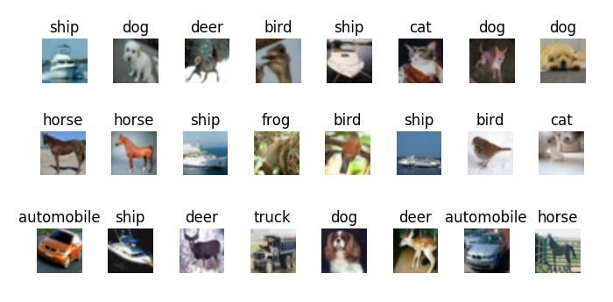
Why CS 109?
Then finally, we will cover machine learning!

Slide 18
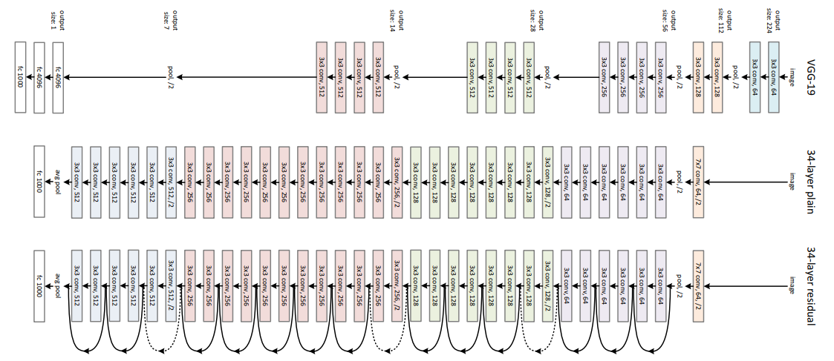
Solution (harder to draw)

Slide 19
One last problem… work with me!
Let Xi be the time at which you see the i-th new word.
Example: Pushing six times yields: penguin, penguin, randomized, hello, randomized, spaceship
Then X1 = 1, X2 = 3, X3 = 4, and X4 = 6.
Group Work
What is E[X1]? (This is not a trick question)
What is E[X2 - X1]? (In expectation, how many pushes after the 1st word before seeing a 2nd new word?)
What is E[X3 - X2]?
For any i = 2, 3, ..., n, what is E[Xi - Xi-1]?
Use your answers above + linearity of expectation: what is the expected number of pushes to see all n words? (Try to simplify to a expression)

Slide 20
What do you want to get out of this?
If you’ve done ACE before, what worked? What would you like to change?
How much independent work / practice would you like compared to review?

Slide 21
Other things you want?
Python review?
Homework tips?

Slide 22
General Course Tips

Slide 23
Structure
Everything builds off of earlier concepts. Make sure you understand these things really well
Chris is great, so don’t be afraid to ask questions, go to OH, etc.

Slide 24
PSET Collaboration
I’m not here to give HW answers
If there are concepts form the HW you want to discuss, let’s bring them up!
You can discuss concepts with this group (and form your own groups)!
DO NOT share/look at written solutions (talk through at high level)
Disclose who you worked with

Slide 25
AI Policy
AI will do this class for you.
The PSETs barely count and are the best practice for the test, so remember it is not worth it
These concepts are actually important and fun!

Slide 26
But…
You can use AI as a great study tool!
Make practice problems
If you have an idea for a fun project, try it out!
Use it to answer your questions
Talk with your favorite assistant before figuring out what questions to ask!
If I prompt you for a question during class, I might ask you to ask an LLM to give a good question

Slide 27
Practice Asking Questions
That’s an objective of this course: be comfortable with asking questions
It’s such an important skill

Slide 28
Onto the material…

Slide 29
Topics Covered Last Week:
Intro to probability
Conditional probability
Bayes’ Theorem
Counting and combinatorics

Slide 30
Specifics to add?
Any specific topics or portions you want to focus on?

Slide 31
Intro to probability

Slide 32
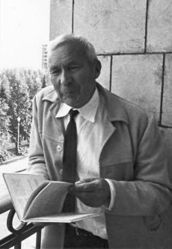
What Is Probability?
Axioms of Probability
Recall: S = all possible outcomes, E = the event.
Axiom 1: 0 ≤ P(E) ≤ 1
Axiom 2: P(S) = 1
Axiom 3: If events E and F are mutually exclusive,
P(E ∪ F) = P(E) + P(F)
Andrey Kolmogorov

Slide 33
Sample Spaces and Events
Sample space S: the set of all possible outcomes of an experiment
Event E: any subset of S (E ⊆ S)
One coin: S = {H, T}. Two coins: S = {HH, HT, TH, TT}
One die: S = {1, …, 6}; “roll is even” is E = {2, 4, 6}

Slide 34
More Notation
E ∪ F = E or F. E ∩ F = EF = E and F. Eᶜ = not E
De Morgan: (E ∪ F)ᶜ = Eᶜ ∩ Fᶜ and (E ∩ F)ᶜ = Eᶜ ∪ Fᶜ

Slide 35
Consequences of the Axioms (draw out visually)
Complement: P(Eᶜ) = 1 − P(E) (E and Eᶜ are disjoint and make up S)
If E and F are mutually exclusive, P(E ∪ F) = P(E) + P(F)
Inclusion–exclusion: P(E ∪ F) = P(E) + P(F) − P(E F)
If E ⊆ F, then P(E) ≤ P(F). P(∅) = 0
Key idea: P(E ∪ F) = P(E) + P(F) − P(EF) P(Eᶜ) = 1 − P(E)

Slide 36
Quick Practice
What is the probability of rolling at least 1 6 in 4 rolls of a fair dice?

Slide 37
Solution
P(at least one 6 in 4 rolls) = 1 − (5/6)⁴ ≈ 0.518
Find the probability of not rolling a 6 on a single roll
Find the probability of not rolling a 6 in all 4 independent rolls
Subtract from 1 to find the probability of at least one 6

Slide 38
Why is this important?
Example: roll a fair 6-sided die.
S = {1,2,3,4,5,6}. Let E = {roll a 1} and F = {roll a 6}.
Probability is between 0 and 1: P(E) = ⅙
Something in the sample space must happen: P(S) = 6/6 = 1
Add mutually exclusive events: A roll can’t be both 1 and 6, so
P(E ∪ F) = P(E) + P(F) = ⅙ + ⅙ = ⅓

Slide 39
Equally Likely Outcomes
If every outcome in S is equally likely: P(E) = |E| / |S|
So probability turns into counting: count the event, count the sample space
Die: P(even) = |{2, 4, 6}| / 6 = 1/2
Card: P(heart) = 13/52 = 1/4
Count E and S the same way (both ordered or both unordered)
Only valid when outcomes really are equally likely (sums of two dice aren’t!)
Key idea: P(E) = |E| / |S|, but only when every outcome is equally likely/uniform random

Slide 40
Let’s do it together
PRACTICE
Roll two dice. What outcomes make up ‘sum is 7’? What is its probability?

Slide 41
Sum Is 7: Answer
SOLUTION
Treat the dice as distinct (die 1, die 2): |S| = 6 · 6 = 36 equally likely outcomes
E = {(1,6), (2,5), (3,4), (4,3), (5,2), (6,1)}, so |E| = 6
P(E) = |E| / |S| = 6/36 = 1/6
Trap: the 11 sums (2 to 12) are NOT equally likely
P(sum = 2) = 1/36, but P(sum = 7) = 6/36
Answer: P(sum = 7) = 6/36 = 1/6

Slide 42
Counting Basics: Sum & Product Rules
Product rule: m outcomes and n outcomes for each one → m · n in total
6-digit entry codes: 10 · 10 · 10 · 10 · 10 · 10 = 1,000,000
Sum rule: if A and B don’t overlap, |A ∪ B| = |A| + |B|
Inclusion–exclusion: |A ∪ B| = |A| + |B| − |A ∩ B|
6 paths through Kilimanjaro, 8 through Mombasa, 2 through both
→ 6 + 8 − 2 = 12 paths

Slide 43
Counting Basics: Order Matters?
Does order matter? Are the objects distinct?
Arrange n distinct objects in a row: n!
Ordered picks of k from n (permutations): n! / (n − k)!
Unordered picks of k from n (combinations): C(n, k) = n! / (k! (n − k)!)
3 of 4 distinct marbles: ordered 4 · 3 · 2 = 24; unordered 24 / 3! = 4
Identical objects: divide out the repeats
BASKETBALL: 10! / (2! 2! 2!) = 453,600
Key idea: order matters → n! / (n − k)! order doesn’t → C(n, k) = n! / (k! (n − k)!)

Slide 44
Conditional Probability

Slide 45
Conditional Probability
Def. The conditional probability of E given F is the probability E occurs given that F already occurred. Sometimes this is also “conditioning on F.”
P(E | F) =
= (# outcomes in E consistent with F) / (# outcomes in S consistent with F)
= |E ∩ F| / |S ∩ F|
= |E ∩ F| / |F|

Slide 46
Conditional Probability: Intuition
Conditioning on F shrinks the sample space down to F
P(E | F) = P(E F) / P(F) (only defined when P(F) > 0)
Two dice: E = sum is 4, F = first die is 2
P(E) = 3/36 = 1/12, but P(E | F) = 1/6: only (2,2) of F’s 6 outcomes
8-sided die: A = even, B = roll ≥ 6 = {6, 7, 8}
P(A | B) = |{6, 8}| / |{6, 7, 8}| = 2/3
Key idea: P(E | F) = P(EF) / P(F)

Slide 47
Inside the World of F: Same Rules
After conditioning on F, every probability rule still holds:
P(Eᶜ | F) = 1 − P(E | F)
P(E ∪ G | F) = P(E | F) + P(G | F) − P(E G | F)
Can we draw these?

Slide 48
The Chain Rule
Super important for language modeling (aside)!
P(E F) = P(E | F) · P(F)
This goes the other way too!
P(E F) = P(F | E) · P(E)
And with more events
P(E F G) = P(E) · P(F | E) · P(G | E, F)

Slide 49
Chain Rule: Examples
Hungry puppy (lecture): P(H) = 0.5, P(K | H) = 0.5
P(H K) = P(H) · P(K | H) = 0.5 · 0.5 = 0.25
Three aces in a row from a shuffled deck (no replacement):
P(A₁ A₂ A₃) = P(A₁) · P(A₂ | A₁) · P(A₃ | A₁ A₂)
= 4/52 · 3/51 · 2/50 = 1/5525
Key idea: P(E₁E₂E₃) = P(E₁) · P(E₂ | E₁) · P(E₃ | E₁E₂), and so on for more events

Slide 50
How can we use the chain rule for LLMs?
What is the modeling task given some text corpus D = “The dog ran over the fence then jumped into the lake for a swim?”
You want to maximize the likelihood of D:
P(D) = P(“The”) * P(“dog”|“The”) * P(“ran”|”The”, “dog”) * …

Slide 51
After conditional probability, what changed when we learned something
Question 1
“Given that the sum of two dice is 7, what is the probability the first die is 2?”
Question 2
“Given that the first die is 2, what is the probability the sum is 7?”

Slide 52
After conditional probability, what changed when we learned something
Question 1
“Given that the sum of two dice is 7, what is the probability the first die is 2?”
Result:1/6
Question 2
“Given that the first die is 2, what is the probability the sum is 7?”
Result:1/6
Did those answers have to match?
This tees up Bayes’ Theorem

Slide 53
Bayes’ Theorem

Slide 54



Bayes’ Theorem (my favorite, and everyone’s)
The #1 rule to remember from this class… can we derive this?
P(A|B) = P(B|A) · P(A) / P(B)
Posterior
Likelihood & Prior
Marginal
P(A|B): Updated belief after evidence
P(B|A) · P(A): Evidence fit & initial belief
P(B): Total probability of evidence

Slide 55
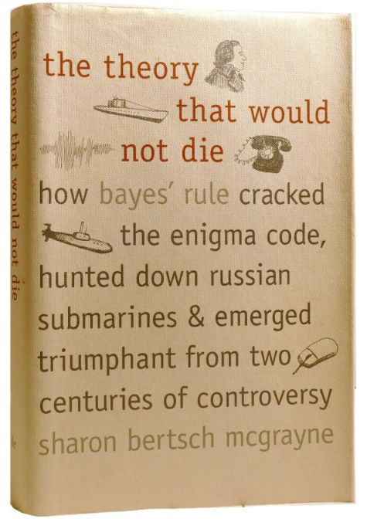

Slide 56
Law of Total Probability

Slide 57
Law of Total Probability (often need with Bayes’ rule)
Split E into pieces using an event M you can condition on:
P(E) = P(EM) + P(EMᶜ) (Mᶜ = “not M”)
= P(E | M) · P(M) + P(E | Mᶜ) · P(Mᶜ)
General: if B₁, B₂, … partition S, P(E) = Σᵢ P(E | Bᵢ) · P(Bᵢ)

Slide 58
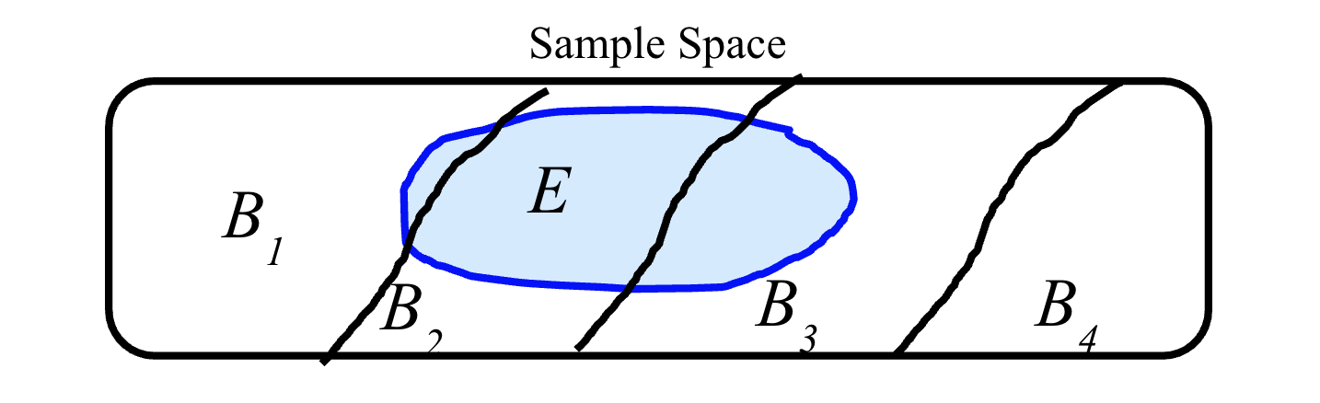
A Good Visual

Slide 59
Law of Total Probability Example
Ex (lecture): 10% of bacteria have a mutation (M). Survival (E): 20% if M, 1% if not.
P(E) = (0.20)(0.10) + (0.01)(0.90) = 0.020 + 0.009 = 0.029
Followup: can we draw this visually?

Slide 60
LOTP: Think in Trees
Branch first on what you can condition on (M or Mᶜ), then on E
Multiply along a branch (chain rule): P(E M) = P(M) · P(E | M)
Add up the branches that end in E (LOTP)
Bacteria: M (0.10) → survive (0.20) = 0.020
Mᶜ (0.90) → survive (0.01) = 0.009
P(E) = 0.029: a weighted average of 20% and 1%
Branches must partition S: no overlaps, nothing missing
Key idea: P(E) = Σᵢ P(E | Bᵢ) P(Bᵢ) for any partition B₁, B₂, …

Slide 61
Deriving Bayes’ Theorem
Chain rule, both ways: P(M E) = P(M | E) · P(E) = P(E | M) · P(M)
Divide by P(E): P(M | E) = P(E | M) · P(M) / P(E)
The denominator usually comes from LOTP:
P(E) = P(E | M) · P(M) + P(E | Mᶜ) · P(Mᶜ)
Bacteria: P(M | E) = (0.20)(0.10) / 0.029 ≈ 0.69
Surviving raises our belief in “mutation” from 10% to 69%
Bayes needs no independence assumption: it’s just the definition, rearranged
Key idea: P(M | E) = P(E | M) P(M) / P(E)

Slide 62
Bayes Vocabulary: Spam Example
60% of email is spam (S). 20% of spam contains “Dear” (D); 1% of non-spam does.
Prior: P(S) = 0.60 (belief before seeing the email)
Likelihood: P(D | S) = 0.20 (how well “spam” explains the evidence)
Normalizing constant: P(D) = (0.20)(0.60) + (0.01)(0.40) = 0.124
Posterior: P(S | D) = 0.12 / 0.124 ≈ 0.97 (belief after the evidence)
Key idea: posterior = likelihood × prior / normalizing constant

Slide 63
Solving Bayes Problems: A Recipe
1. Define events with letters (Z = has Zika, T = tests positive)
2. Write the goal: P(Z | T)
3. Inventory what you know: prior P(Z), likelihoods P(T | Z), P(T | Zᶜ)
4. Apply Bayes: P(Z | T) = P(T | Z) P(Z) / P(T)
5. Get P(T) from LOTP

Slide 64
Someone ask me a question

Slide 65
Independence

Slide 66
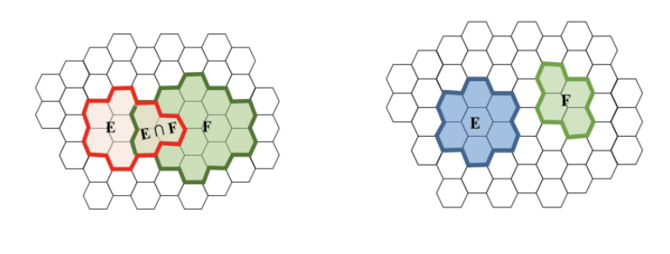
Mutually Exclusive or Independent?
Notes:
Left picture: E and F overlap (E ∩ F is not empty) → NOT mutually exclusive. They might still be independent: check whether P(EF) = P(E) · P(F).
Right picture: E and F don’t overlap → mutually exclusive: P(EF) = 0, so P(E ∪ F) = P(E) + P(F) (easy OR, Axiom 3).
Trap: mutually exclusive is NOT the same as independent. If P(E), P(F) > 0, disjoint events are DEPENDENT: learning E happened tells you F didn’t, so P(F | E) = 0 ≠ P(F).
Independent means P(E | F) = P(E), equivalently P(EF) = P(E) · P(F) (easy AND).
(Source: Javo’s Fall 2025 W2 deck, “Mutually Exclusive or Independent?” → “Independence” slides.)

Slide 67
Independent vs. Mutually Exclusive
Independent: P(E F) = P(E) · P(F), or equivalently P(E | F) = P(E)
Learning F tells you nothing about E
Mutually exclusive: E F = ∅, so P(E F) = 0
Learning F tells you E did NOT happen
Implies P(E ∪ F) = P(E) + P(F)
If P(E) > 0 and P(F) > 0, mutually exclusive events are always dependent
Can we prove this?
Key idea: independent → P(EF) = P(E) P(F) mutually exclusive → P(EF) = 0

Slide 68
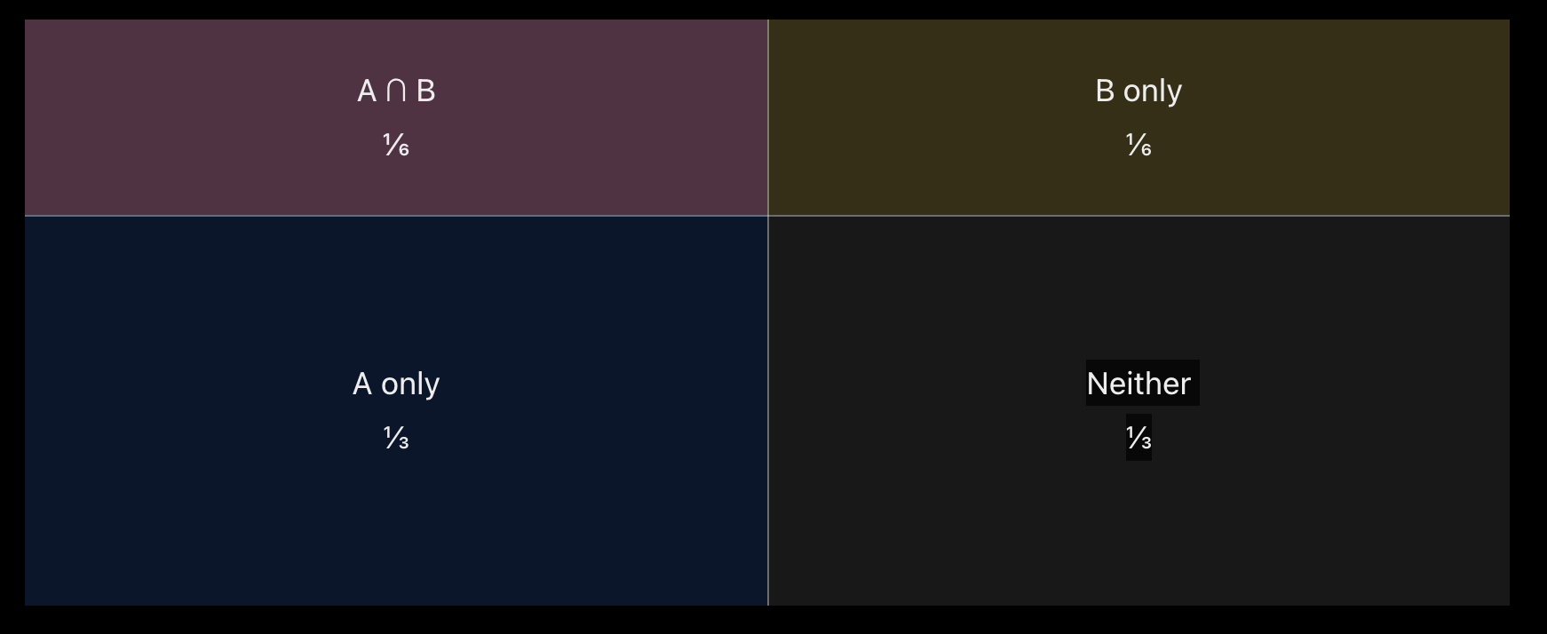
A Visual

Slide 69
How to Prove Two Events Independent?
Show that the probability of both together equals the probability of each multiplied!
Assume we have two events A and B — show P(AB) = P(A) P(B)
That’s it!

Slide 70
Independence: Problem
Roll two dice. E = first die is 1, F = sum is 7, G = sum is 5
Task for you: which are dependent? Which are independent?

Slide 71
Independence: Solution
P(E) = 1/6, P(F) = 6/36 = 1/6, P(G) = 4/36 = 1/9
P(E F) = P{(1,6)} = 1/36 = P(E) · P(F) → independent
P(E G) = P{(1,4)} = 1/36 ≠ (1/6)(1/9) = 1/54 → dependent
Why? Whatever die 1 shows, exactly one value of die 2 makes a sum of 7. For a sum of 5, a 5 or 6 on die 1 makes it impossible.

Slide 72
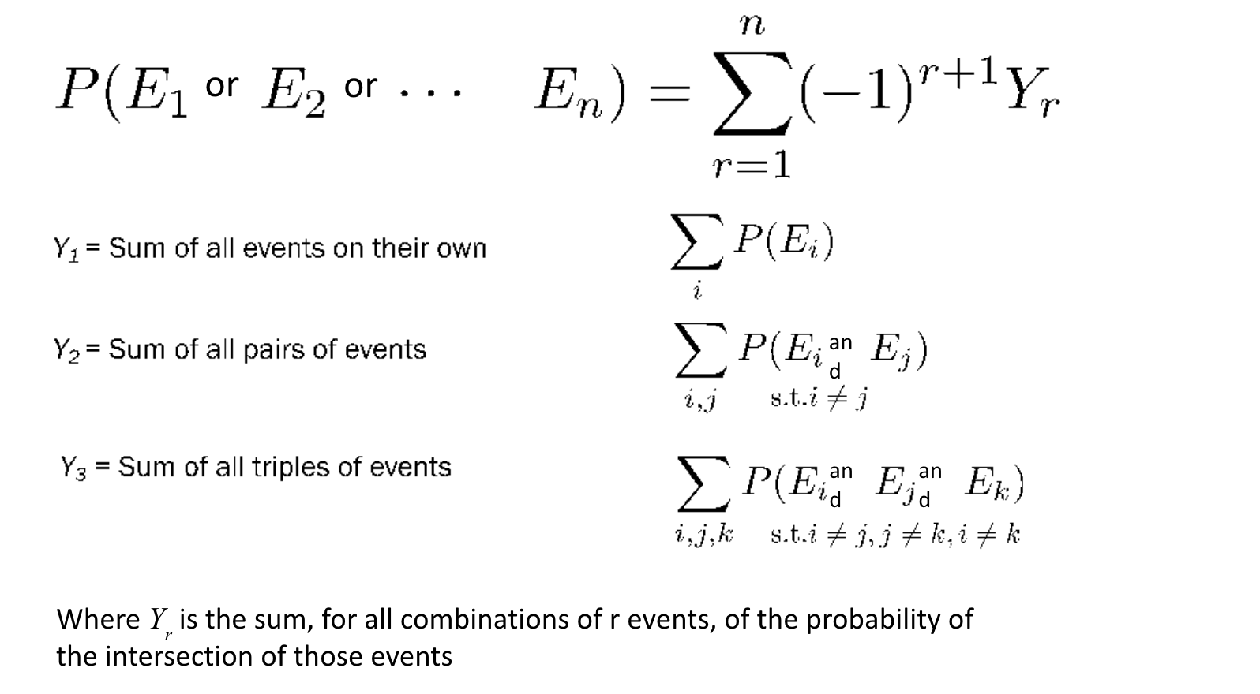
Inclusion-Exclusion

Slide 73
Review Problems

Slide 74
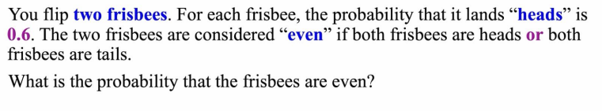
Frisbee Problem
PRACTICE
Notes:
Problem (text of the screenshot): You flip two frisbees. For each frisbee, the probability that it lands “heads” is 0.6. The two frisbees are considered “even” if both frisbees are heads or both frisbees are tails. What is the probability that the frisbees are even?
Answer: 0.6² + 0.4² = 0.36 + 0.16 = 0.52 (full solution on the next slide).
Source: Javo’s Fall 2025 109ACE W2.pdf, p. 71 (screenshot of a CS109 lecture slide, #85, “Practice: Lets do the Frisbee Problem”).

Slide 75
Frisbee Problem: Solution
SOLUTION
Let H₁, H₂ = frisbee 1, 2 lands heads. The two flips are independent.
Even = (both heads) OR (both tails). These can’t both happen → mutually exclusive → just add (easy OR)
P(both heads) = P(H₁) · P(H₂) = 0.6 · 0.6 = 0.36 (easy AND)
P(both tails) = P(H₁ᶜ) · P(H₂ᶜ) = 0.4 · 0.4 = 0.16
Answer: P(even) = 0.36 + 0.16 = 0.52

Slide 76
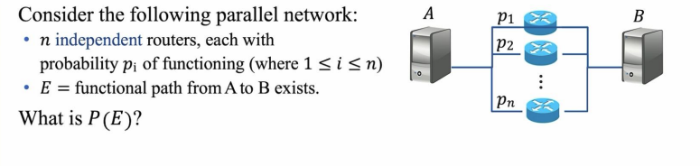
Network Reliability
PRACTICE
Notes:
Problem (text of the screenshot): Consider the following parallel network: n independent routers, each with probability pᵢ of functioning (where 1 ≤ i ≤ n). E = functional path from A to B exists. What is P(E)? (Diagram: A connects to B through n routers in parallel.)
Answer: P(E) = 1 − ∏ᵢ (1 − pᵢ) (full solution on the next slide).
Source: Javo’s Fall 2025 109ACE W2.pdf, p. 72 (screenshot of Chris Piech’s CS109 lecture slide #87, “Piech, CS109, Stanford University”).

Slide 77
Network Reliability: Solution
SOLUTION
E = at least one router works: an OR of n overlapping events (hard OR)
Flip it (De Morgan): Eᶜ = every router fails: an AND of independent events (easy AND)
P(Eᶜ) = (1 − p₁)(1 − p₂) ⋯ = ∏ᵢ (1 − pᵢ) (product over i = 1, …, n)
Sanity check: 3 routers, each pᵢ = 0.9 → P(E) = 1 − (0.1)³ = 0.999
Answer: P(E) = 1 − ∏ᵢ (1 − pᵢ)

Slide 78
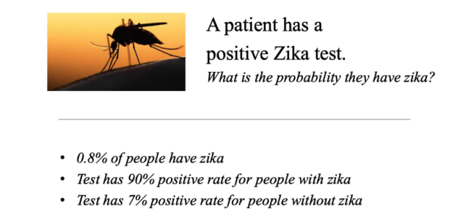
Zika Virus…
PRACTICE
Notes:
Problem (text of the screenshot): A patient has a positive Zika test. What is the probability they have Zika? 0.8% of people have Zika. The test has a 90% positive rate for people with Zika. The test has a 7% positive rate for people without Zika.
Answer: P(Z | T) = 0.0072 / 0.07664 ≈ 0.094 ≈ 9% (full solution on the next two slides).
Heads-up: the screenshot already shows “The right answer is 9%”, so students see the answer before they solve it.
Source: Javo’s Fall 2025 109ACE W2.pdf, p. 73 (screenshot of Piech’s CS109 “But Its not Always Intuitive” slide). The same example is in Chris Gregg’s Lecture 1 (1-Welcome.pptx, slides 28–30, “Unintuitive Probability”).

Slide 79
Zika Virus: Solution
SOLUTION
Define events: Z = has Zika, T = tests positive. Want P(Z | T).
Know: P(Z) = 0.008 (prior), P(T | Z) = 0.90, P(T | Zᶜ) = 0.07
Step 1 – LOTP for the denominator:
P(T) = P(T | Z) · P(Z) + P(T | Zᶜ) · P(Zᶜ)
= (0.90)(0.008) + (0.07)(0.992)
= 0.0072 + 0.06944 = 0.07664
P(zika | positive) = P(positive | zika) P(zika) / P(positive)
Answer: P(Zika | positive test) ≈ 0.094 ≈ 9%

Slide 80
More Practice

Slide 81
Warm-up 1: 8-Sided Die
PRACTICE
Roll a fair 8-sided die (faces 1 through 8).
A = the result is even. B = the result is ≥ 6.
(a) What is P(A)?
(b) What is P(B)?
(c) What is P(A ∩ B)?
(d) What is P(A ∪ B)?
Hint: write out the outcomes in each event.
Notes:
Source: CS109A Fall 2022 Week 2 Notes (Julia Kadie & Ian Tullis), Problem 5(a)–(d). The same problem appears in the Spring 2022 Week 2 Notes (Tullis), the CS109ACE Fall 2023 Week 2 Notes (Drive file 16MA98vqMGIuMua5cu_NNbTaBjiAlWMr2), and CS 109 ACE Spring 2023 Session 1 Problems & Solutions. Answers match the archived solutions: 1/2, 3/8, 1/4, 5/8. Parts (e)–(i) are used later as Conditional 3.

Slide 82
Warm-up 1: Solution
SOLUTION
S = {1, …, 8}, all equally likely, so P(E) = |E| / 8
(a) A = {2, 4, 6, 8} → P(A) = 4/8 = 1/2
(b) B = {6, 7, 8} → P(B) = 3/8
(c) A ∩ B = {6, 8} → P(A ∩ B) = 2/8 = 1/4
(d) Inclusion–exclusion: P(A ∪ B) = 1/2 + 3/8 − 1/4 = 5/8
Check by listing: A ∪ B = {2, 4, 6, 7, 8}, 5 outcomes → 5/8 ✓
Answers: (a) 1/2 (b) 3/8 (c) 1/4 (d) 5/8

Slide 83
Warm-up 2: Birthday Party
PRACTICE
You have 6 friends: George, Hannah, Kevin, Shree, Ulo, and Sam.
(a) How many ways are there to choose 2 of the 6 friends to invite?
(b) Shree and Sam must come together or not at all. Now how many ways are there to choose 2 friends?
Notes:
Source: CS109A Fall 2022 Week 2 Notes (Kadie & Tullis), Problem 1(a)–(b). Also in the Spring 2022 Week 2 Notes and the Fall 2023 Week 2 Notes (16MA98vqMGIuMua5cu_NNbTaBjiAlWMr2), with worked versions in the F23/F24/W24 section iPad notes. Answers: 15 and 7. Skipped part (c) (the n-choose-k identities) for time; it's a good extension if students finish early.

Slide 84
Warm-up 2: Solution
SOLUTION
(a) Order doesn’t matter: C(6, 2) = 6! / (2! · 4!) = 15
(b) Split into cases that can’t overlap (sum rule):
Case 1: invite the pair {Shree, Sam} → 1 way
Case 2: invite neither → choose 2 of the other 4: C(4, 2) = 6
Total = 1 + 6 = 7
(Inviting only one of Shree and Sam isn’t allowed.)
Answers: (a) 15 (b) 7

Slide 85
Warm-up 3: Entry Codes
PRACTICE
Entry codes are 6 digits and may start with 0 (e.g., 379009, 012345, 000000).
(a) How many codes are possible?
(b) How many are the same two digits repeated three times (121212, 333333)?
(c) How many use each of the digits 1–6 exactly once (254631)?
(d) Stretch: a code is valid if its digits sum to exactly 9. What is P(valid) for a code picked uniformly at random?
Notes:
Source: CS109A Fall 2022 Week 2 Notes (Kadie & Tullis), Problem 2 (“Combinatorics of Entry Codes”), parts (a), (b), (c), and (f). Also in the Spring 2022 and Fall 2023 Week 2 Notes. Answers: 10^6, 100, 720, and 2002/10^6 ≈ 0.002. All were verified by brute force in Python over all 10^6 codes. Part (d) uses stars and bars, which may not have been covered in lecture yet, so it's marked “Stretch.” Skipped the palindrome part (19,900) and the “three in a row” part for time.

Slide 86
Warm-up 3: Solution (1/2)
SOLUTION
(a) 10 choices for each of 6 positions (product rule): 10⁶ = 1,000,000
(b) The first two digits fix the whole code: 10 · 10 = 100
(c) Arrange 6 distinct digits in a row: 6! = 720
(Careful in (b): 333333 counts once, as the pair “33”.)

Slide 87
Warm-up 3: Solution (2/2)
SOLUTION
(d) Count digit strings with d₁ + d₂ + … + d₆ = 9, where each digit ≥ 0
No digit can exceed 9, since the total is only 9
Stars and bars: 9 stars and 5 bars in a row → C(14, 5) = 2002
P(valid) = 2002 / 10⁶ ≈ 0.002
(Checked by brute force over all 10⁶ codes.)
Answers: (a) 10⁶ (b) 100 (c) 720 (d) 2002 / 10⁶ ≈ 0.002

Slide 88

Extra (for this week): Stars and Bars
10 identical units among 3 labeled bins
(10 + (3-1)) choose 2

Slide 89
Counting Challenge: Six-Card Poker
PRACTICE
A casino deals 6-card poker hands from a standard 52-card deck (hands are unordered).
(a) Three pair: 2 cards of one rank, 2 of another, and 2 of a third. What is P(three pair)?
(b) Pyramid: 3 cards of one rank, 2 of another, and 1 of a third. What is P(pyramid)?
Notes:
Source: CS109A Spring 2022 Week 3 Notes (Ian Tullis), Problem 7 (six-card poker), parts (a) and (c). Also in the Fall 2022 Week 3 Problems, the Fall 2023 Week 3 Notes, and the Winter 2025 Week 3 Handout. Answers match the archived solutions: 594/195,755 and 1584/195,755, re-verified in Python. Skipped part (b) (double straight, 324/2,544,815) for time.

Slide 90
Solution: Six-Card Poker
SOLUTION
Sample Space: |S| = C(52, 6) = 20,358,520 unordered hands
(a) Three pair: Choose 3 ranks, then choose 2 suits for each rank:
|E| = C(13, 3) · C(4, 2)³ = 286 · 216 = 61,776 → P(three pair) = 61,776 / 20,358,520 ≈ 0.3034%
(b) Pyramid (3–2–1): Choose distinct ranks for triple, pair, single (13 · 12 · 11), then pick suits:
|E| = (13)(12)(11) · C(4, 3) · C(4, 2) · C(4, 1) = 1,716 · 96 = 164,736 → P(pyramid) = 164,736 / 20,358,520 ≈ 0.8092%
Answer: P(three pair) ≈ 0.3034%, P(pyramid) ≈ 0.8092%

Slide 91
Warm-up 4: Poker Straight
PRACTICE
Draw a 5-card hand from a standard 52-card deck.
A straight is 5 cards of consecutive ranks, e.g., 2-3-4-5-6. An ace can be low (A-2-3-4-5) or high (10-J-Q-K-A). Suits don’t matter (count straight flushes too).
What is P(straight)?
First, describe the sample space and the event in words.
Notes:
Source: the “Revisiting the straight poker hand” walkthrough in the CS109ACE Fall 2023 Week 2 slides, reused in the W24 and S24 Week 2 slides (Michelle, adapted from Julia Kadie’s F22 section 1 slides). Answer: 10·4^5 / C(52,5) = 10,240 / 2,598,960 ≈ 0.00394, verified in Python. The “why not ×2” point comes from the speaker-note Q&A in the W24/S24 decks.

Slide 92
Warm-up 4: Solution
SOLUTION
S = all 5-card hands (unordered): |S| = C(52, 5) = 2,598,960
E = all straights. Build one step by step (product rule):
Pick the lowest rank (A, 2, …, 10): 10 ways, which fixes all 5 ranks
Pick a suit for each card: 4⁵ = 1024 ways
|E| = 10 · 1024 = 10,240 → P(straight) = 10,240 / 2,598,960 ≈ 0.0039
Why not ×2 for “up or down”? Naming a straight by its lowest card counts each hand exactly once.
Answer: P(straight) = 10,240 / 2,598,960 ≈ 0.0039

Slide 93
Warm-up 5: The Casino Game
PRACTICE
Place 2 tokens on dice sums (2–12). Both can go on the same number.
The dealer rolls two dice twice. On each roll, if a token is on that sum, one token is removed and you win $1000.
(a) Strategy (7, 7): find P(win $2000), P(win $0), and P(win $1000).
(b) Strategy (2, 7): same questions.
(c) Preview of expectation: which strategy wins more on average?
Notes:
Source: CS109A Fall 2022 Week 2 Notes, Section III “Return to the Casino,” Problems 3–4. Also in the Spring 2022 and Fall 2023 Week 2 Notes and Spring 2023 Session 1. Answers, checked exactly in Python: (7,7) gives 1/36, 25/36, 10/36, avg $333.33. (2,7) gives 1/108, 841/1296, 443/1296, avg ≈ $360.34. The best placement is (6,7), avg ≈ $564.04. Expected value hasn’t been taught yet, so part (c) is framed as a preview.

Slide 94
Warm-up 5: Solution (1/2)
SOLUTION
(a) Strategy (7, 7): P(sum = 7) = 6/36 = 1/6 on each roll, and the rolls are independent
P($2000) = (1/6)(1/6) = 1/36
P($0) = (5/6)(5/6) = 25/36
P($1000) = 1 − 1/36 − 25/36 = 10/36 (complement!)
Average winnings: 2000 · (1/36) + 1000 · (10/36) ≈ $333.33

Slide 95
Warm-up 5: Solution (2/2)
SOLUTION
(b) Strategy (2, 7): P(2) = 1/36, P(7) = 6/36
$2000: one roll is a 2 and the other a 7: 2 · (1/36)(6/36) = 1/108
$0: neither roll is a 2 or a 7: (29/36)² = 841/1296
$1000: 1 − 1/108 − 841/1296 = 443/1296
(c) Average: 2000 · (1/108) + 1000 · (443/1296) ≈ $360.34 > $333.33
Two different numbers cover more outcomes (best: 6 & 7, ≈ $564)
Answer (c): strategy (2, 7) wins more on average: ≈ $360 vs. ≈ $333

Slide 96
Conditional 1: Three Coin Flips
PRACTICE
You flip a fair coin 3 times.
Given that you saw at least one head, what is the probability that you saw at least two heads?
Notes:
Source: CS 109 ACE Session 2 (Spring 2023; Samuel Chian, Julia Kadie, Ian Tullis), Conditional Probability Problem 3. Archived solution is in “Session 2 Solutions.pdf”. Answer: 4/7, verified by enumerating all 8 outcomes in Python.

Slide 97
Conditional 1: Solution
SOLUTION
S has 2³ = 8 equally likely outcomes
F = at least one head = everything except TTT → |F| = 7
E = at least two heads = {HHT, HTH, THH, HHH} → |E| = 4, all inside F
P(E | F) = |E ∩ F| / |F| = 4/7 ≈ 0.571
Compare: P(E) = 4/8 = 1/2, so learning F raised the probability
Answer: P(at least 2 heads | at least 1 head) = 4/7 ≈ 0.571

Slide 98
Conditional 2: Two Dice
PRACTICE
Roll two fair dice. X = the first die, Y = the second die.
(a) What is P(X > 3 | Y = 2)?
(b) What is P(X = 4 | X + Y = 8)?
Notes:
Source: CS 109 ACE Session 2 (Spring 2023), Random Variables Problem 1(b)–(c). I rephrased it in terms of events, since random variables come later. Archived solution in “Session 2 Solutions.pdf”. Answers: 1/2 and 1/5. The dice-conditioning idea mirrors Gregg’s Lecture 2 example (sum = 4 given D1 = 2).

Slide 99
Conditional 2: Solution
SOLUTION
(a) The dice are independent, so knowing Y tells us nothing about X:
P(X > 3 | Y = 2) = P(X > 3) = 3/6 = 1/2
(b) Shrink S to X + Y = 8: {(2,6), (3,5), (4,4), (5,3), (6,2)}
5 equally likely outcomes, and only (4,4) has X = 4 → 1/5
By definition: P(X = 4, Y = 4) / P(X + Y = 8) = (1/36)/(5/36) = 1/5
Answers: (a) 1/2 (b) 1/5

Slide 100
Conditional 3: 8-Sided Die, Continued
PRACTICE
Same die: A = even, B = ≥ 6. From Warm-up 1: P(A) = 1/2, P(B) = 3/8, P(A ∩ B) = 1/4
(a) What is P(A | B)? (b) What is P(B | A)?
(c) Is P(A ∩ B) = P(A) P(B)? Always, never, or sometimes?
(d) Is P(A ∩ B) = P(A | B) P(B)? Always, never, or sometimes?
(e) C = the result is a cube (1 or 8). What is P(C | A ∩ B)?
Notes:
Source: CS109A Fall 2022 Week 2 Notes, Problem 5(e)–(i) (“Grappling With Conditional Probability”). Same problem in the Spring 2022 and Fall 2023 Week 2 Notes and Spring 2023 Session 1 §3.3 #3. Answers match the archived solutions: 2/3; 1/2; no (3/16 ≠ 1/4), holds only under independence; always; 1/2.

Slide 101
Conditional 3: Solution
SOLUTION
(a) P(A | B) = P(A ∩ B) / P(B) = (1/4) / (3/8) = 2/3 (in {6, 7, 8}, the evens are 6 and 8)
(b) P(B | A) = (1/4) / (1/2) = 1/2, which is not P(A | B)!
(c) Not here: P(A) P(B) = 3/16 ≠ 1/4. Sometimes: true only if A and B are independent
(d) Always true: this is the chain rule (the definition, rearranged)
(e) A ∩ B = {6, 8}, and only 8 is a cube → P(C | A ∩ B) = 1/2
Answers: (a) 2/3 (b) 1/2 (c) sometimes (d) always (e) 1/2

Slide 102
Chain Rule 1: The Late Cat (Part 1)
PRACTICE
It rains (R) 1/3 of the time. Heavy traffic (T) happens with probability 1/2 if it rains, 1/4 if not.
A cat drives to work. It is late (L) with probability 1/2 if there is rain and traffic, 1/8 if there is neither, and 1/4 otherwise.
(a) On a random day, what is the probability it is not raining, there is heavy traffic, and the cat isn’t late?
Notes:
Source: CS 109 ACE Session 2 (Spring 2023), Conditional Probability Problem 5(a) (rain / traffic / late cat). Parts (b) and (c) are under LOTP 2. Answer: (2/3)(1/4)(3/4) = 1/8, which matches the archived solution and was verified with exact fractions in Python.

Slide 103
Chain Rule 1: Solution
SOLUTION
Want P(Rᶜ T Lᶜ). Chain rule: each factor conditions on the ones before it
P(Rᶜ T Lᶜ) = P(Rᶜ) · P(T | Rᶜ) · P(Lᶜ | Rᶜ T)
P(Rᶜ) = 1 − 1/3 = 2/3
P(T | Rᶜ) = 1/4
P(Lᶜ | Rᶜ T) = 1 − 1/4 = 3/4 (the “otherwise” case, complemented)
Answer: P(Rᶜ T Lᶜ) = (2/3)(1/4)(3/4) = 1/8

Slide 104
Chain Rule 2: White Elephant
PRACTICE
n people each bring a gift. One at a time, each person is randomly assigned a gift from the pile (possibly their own).
(a) What is the probability that all n people get their own gift?
(b) Exactly n − 1 people?
(c) Exactly n − 2 people?
(d) You may take your turn whenever you like. Which turn maximizes your chance of getting your own gift?
Notes:
Source: CS109A Spring 2022 Week 3 Notes (Tullis), Problem 2 (“White Elephant”). Also in the Fall 2022 Week 3 Problems, the Fall 2023 Week 3 Notes, the Winter 2025 Week 3 Handout, and CS 109 ACE Session 2 (Spring 2023) Problem 7(a)–(e). It was also used live in the F23/W24/S24/W25 Week 3 slides. Answers match the archived solutions: 1/n!, 0, 1/(2(n−2)!), and 1/n for any turn. Derangement values (1/3, 3/8, 11/30 for n = 3, 4, 5) were checked by brute force in Python.

Slide 105
Chain Rule 2: Solution (1/2)
SOLUTION
(a) Chain rule: P(person 1 gets theirs) = 1/n, then 1/(n − 1), …
P = (1/n) · (1/(n − 1)) · … · (1/1) = 1/n!
(b) 0: a wrong gift belongs to someone else, who then can’t get theirs
(c) Exactly one pair swaps; everyone else is forced
C(n, 2) ways out of n! → P = C(n, 2) / n! = 1 / (2 (n − 2)!)

Slide 106
Chain Rule 2: Solution (2/2)
SOLUTION
(d) It doesn’t matter: your chance is always 1/n
Go first: 1/n
Wait k turns: your gift must survive them, then you must draw it
P = (n − k)/n · 1/(n − k) = 1/n (chain rule again!)
Intuition: your gift is equally likely to be anywhere in the order
Bonus: P(nobody gets theirs) = 1/3 (n = 3), 3/8 (n = 4), → 1/e
Answers: (a) 1/n! (b) 0 (c) 1 / (2 (n − 2)!) (d) any turn: always 1/n

Slide 107
Independence 1: Penny and Nickel
PRACTICE
Flip one penny and one nickel.
A: the penny comes up tails
B: the nickel comes up tails
C: neither coin comes up tails
D: exactly one coin comes up tails
Which pairs of these events, if any, are independent?
Notes:
Source: CS109ACE Fall 2023 Week 3 Notes, Problem 3 (penny and nickel). Same in the Spring 2022 and Fall 2022 Week 3 Notes, the Winter 2025 Week 3 Handout, and CS 109 ACE Session 2 (Spring 2023) Problem 2. Answer, matching the archived solutions: independent pairs are (A,B), (A,D), and (B,D). C is mutually exclusive with each of A, B, and D, so those pairs are dependent.

Slide 108
Independence 1: Solution
SOLUTION
S = {HH, HT, TH, TT} (penny first). P(A) = P(B) = P(D) = 1/2, P(C) = 1/4
A, B: P(AB) = P(TT) = 1/4 = (1/2)(1/2) → independent
A, D: P(AD) = P(TH) = 1/4 = (1/2)(1/2) → independent (surprise!)
B, D: P(BD) = P(HT) = 1/4 = (1/2)(1/2) → independent
A & C, B & C, C & D: disjoint, so P = 0 ≠ product → dependent
Takeaway: check the definition, because intuition can mislead
Answer: A & B, A & D, B & D are independent; every pair with C is not

Slide 109
Independence 2: mRNA Patterns
PRACTICE
An mRNA string has 8 letters. Each letter is generated independently: P(A) = P(U) = 1/3, P(C) = P(G) = 1/6.
Vᵢ = the pattern AGUA starts at position i.
(a) What is P(V₁)?
(b) Are V₁ and V₂ independent?
(c) Are V₁ and V₄ independent?
(d) Are V₁ and V₅ independent?
Notes:
Source: CS109ACE Fall 2023 Week 3 Notes, Problem 6 (mRNA / AGUA). Same in the Spring 2022 and Fall 2022 Week 3 Notes, the Winter 2025 Week 3 Handout, and CS 109 ACE Session 2 (Spring 2023) Random Variables Problem 4. Used parts (a), (c), (d), (e). Skipped (b), which is the same as (a), and (f), which needs expectation. Answers match the archived solution: 1/162; dependent; dependent; independent. I added P(V₄ | V₁) = 1/54 to make (c) concrete (verified by hand).

Slide 110
Independence 2: Solution
SOLUTION
(a) The letters are independent: P(V₁) = (1/3)(1/6)(1/3)(1/3) = 1/162
(b) Dependent: V₁ puts a G in position 2, so AGUA can’t start there
P(V₂ | V₁) = 0 ≠ 1/162
(c) Dependent: V₁ puts an A in position 4, giving V₄ a head start
P(V₄ | V₁) = P(G, U, A in 5–7) = (1/6)(1/3)(1/3) = 1/54 > 1/162
(d) Independent: positions 1–4 and 5–8 don’t overlap, and letters are independent
Answers: (a) 1/162 (b) dependent (c) dependent (d) independent

Slide 111
Independence 3 (Challenge): Three Events
PRACTICE
For events A, B, and C:
A and C are independent; B and C are independent
A and B are mutually exclusive
P(A ∪ C) = 2/3, P(B ∪ C) = 3/4, P(A ∪ B ∪ C) = 11/12
Find P(A), P(B), and P(C).
Notes:
Source: CS 109 ACE Session 2 (Spring 2023), Conditional Probability Problem 1. Archived solution in “Session 2 Solutions.pdf”. Answer: P(A) = 1/3, P(B) = 1/2, P(C) = 1/2. Verified in Python with an exact-fraction search. Note: the archived solution’s 3-event inclusion–exclusion line omits the −P(A∩C) term, but its final answer is correct. The solution slides here use the full, correct equation (3).

Slide 112
Independence 3: Solution (1/2)
SOLUTION
Let a = P(A), b = P(B), c = P(C)
Independence: P(AC) = ac, P(BC) = bc. Disjoint: P(AB) = P(ABC) = 0
Inclusion–exclusion gives three equations:
(1) a + c − ac = 2/3
(2) b + c − bc = 3/4
(3) a + b + c − ac − bc = 11/12

Slide 113
Independence 3: Solution (2/2)
SOLUTION
(1) + (2) − (3): everything cancels except c
c = 2/3 + 3/4 − 11/12 = 6/12 = 1/2
Plug into (1): a + 1/2 − a/2 = 2/3 → a/2 = 1/6 → a = 1/3
Plug into (2): b + 1/2 − b/2 = 3/4 → b/2 = 1/4 → b = 1/2
Check (3): 1/3 + 1/2 + 1/2 − 1/6 − 1/4 = 11/12 ✓
Answer: P(A) = 1/3, P(B) = 1/2, P(C) = 1/2

Slide 114
LOTP 1: Two-Step Marbles
PRACTICE
Step 1: draw a marble from a bag of 1 red, 2 green, and 1 blue marble. Its color picks a bucket.
Step 2: draw a marble from that bucket. P(blue marble) is:
1/4 in the red bucket, 0 in the green bucket, 1/3 in the blue bucket
A = the step-2 marble is blue.
(a) What is P(A)?
(b) Given A, what is the probability we used the red bucket?
Notes:
Source: the two-step marble LOTP/Bayes walkthrough in the CS109ACE Fall 2023 section 2 slides, reused in the W24, S24, and W25 Week 3 slides and the F24 Week 3 slides. The original shows the buckets as images; I typed the given probabilities (P(R) = ¼, P(G) = ½, P(B) = ¼; P(A|R) = ¼, P(A|G) = 0, P(A|B) = ⅓). Answers: P(A) = 7/48 ≈ 0.146, P(R | A) = 3/7, verified with exact fractions. HEADS-UP: the archived slides write the red branch as ¼·½ instead of ¼·¼, and round the total (5/24 ≈ 0.208) to “.2”. That gives P(A) = 0.2 and P(R|A) = 0.125/0.2. The corrected values are used here.

Slide 115
LOTP 1: Solution (1/2)
SOLUTION
Partition on the step-1 color: P(R) = 1/4, P(G) = 2/4 = 1/2, P(B) = 1/4
Likelihoods: P(A | R) = 1/4, P(A | G) = 0, P(A | B) = 1/3
(a) LOTP: P(A) = P(A | R) P(R) + P(A | G) P(G) + P(A | B) P(B)
= (1/4)(1/4) + (0)(1/2) + (1/3)(1/4)
= 1/16 + 0 + 1/12 = 7/48 ≈ 0.146

Slide 116
LOTP 1: Solution (2/2)
SOLUTION
(b) Bayes: P(R | A) = P(A | R) P(R) / P(A)
= (1/16) / (7/48) = 3/7 ≈ 0.43
Prior P(R) = 1/4 → posterior 3/7: seeing blue makes “red bucket” more likely
Check: P(B | A) = (1/12) / (7/48) = 4/7 and P(G | A) = 0
3/7 + 4/7 + 0 = 1 ✓
Answers: (a) P(A) = 7/48 ≈ 0.146 (b) P(R | A) = 3/7 ≈ 0.43

Slide 117
LOTP 2: The Late Cat (Part 2)
PRACTICE
Same setup as Chain Rule 1:
P(R) = 1/3; P(T | R) = 1/2, P(T | Rᶜ) = 1/4
P(L | R T) = 1/2, P(L | Rᶜ Tᶜ) = 1/8, and 1/4 otherwise
(b) What is the probability the cat is late?
(c) The manager knows the cat was late today. What is the probability it rained?
Notes:
Source: CS 109 ACE Session 2 (Spring 2023), Conditional Probability Problem 5(b)–(c) (rain / traffic / late cat). Answers match the archived solution (“Session 2 Solutions.pdf”): P(L) = 11/48 ≈ 0.229 and P(R | L) = 6/11 ≈ 0.545. Verified with exact fractions in Python. Part (c) is really a Bayes question; it sits here because the LOTP step does most of the work.

Slide 118
LOTP 2: Solution (1/2)
SOLUTION
(b) Partition on the 4 (rain, traffic) cases. Chain rule on each branch:
R T: (1/3)(1/2) = 1/6 → late: (1/6)(1/2) = 1/12
R Tᶜ: (1/3)(1/2) = 1/6 → late: (1/6)(1/4) = 1/24
Rᶜ T: (2/3)(1/4) = 1/6 → late: (1/6)(1/4) = 1/24
Rᶜ Tᶜ: (2/3)(3/4) = 1/2 → late: (1/2)(1/8) = 1/16
LOTP: P(L) = 1/12 + 1/24 + 1/24 + 1/16 = 11/48 ≈ 0.229

Slide 119
LOTP 2: Solution (2/2)
SOLUTION
(c) Bayes: P(R | L) = P(R L) / P(L)
P(R L) = the two rainy branches = 1/12 + 1/24 = 1/8
P(R | L) = (1/8) / (11/48) = 6/11 ≈ 0.545
Prior 1/3 → posterior 6/11: a late cat is evidence of rain
Sanity check: the answer is between 0 and 1, and it went up, as expected
Answers: (b) P(L) = 11/48 ≈ 0.229 (c) P(R | L) = 6/11 ≈ 0.545

Slide 120
Bayes 1: SARS Test
PRACTICE
A test detects SARS 98% of the time when a person has it. It has a 1% false-positive rate. 0.5% of the population has SARS.
(a) You test positive. What is P(SARS | positive)?
(b) You test negative. What is P(SARS | negative)?
Notes:
Source: Chris Gregg’s Fall 2026 CS109 Lecture 2 (“2-Conditional Probability and Bayes.pptx”), slides 90 (“SARS Virus Testing”, ≈ 0.330) and 101 (“Why it is still good to get tested”, ≈ 0.0001). Those slides come from the standard Piech/Gregg CS109 deck. This is not from the ACE archive: the archive’s Bayes problems are all used elsewhere (Zika, fairness, marbles, late cat), so this adds one more rep. Lecture shows only the final numbers; the full worked solution is on the next two slides. Verified in Python: 0.0049/0.01485 = 0.32997 and 0.0001/0.98515 = 0.000102.

Slide 121
Bayes 1: Solution (1/2)
SOLUTION
F = has SARS, E = tests positive. Prior: P(F) = 0.005
Likelihoods: P(E | F) = 0.98, P(E | Fᶜ) = 0.01
LOTP: P(E) = (0.98)(0.005) + (0.01)(0.995) = 0.0049 + 0.00995 = 0.01485
(a) P(F | E) = 0.0049 / 0.01485 ≈ 0.330
With 1000 people: about 5 have SARS and test positive, and about 10 healthy people test positive → about 5 / 15 ≈ 1/3

Slide 122
Bayes 1: Solution (2/2)
SOLUTION
(b) Now the evidence is Eᶜ: P(Eᶜ | F) = 0.02, P(Eᶜ | Fᶜ) = 0.99
P(Eᶜ) = (0.02)(0.005) + (0.99)(0.995) = 0.0001 + 0.98505 = 0.98515
P(F | Eᶜ) = 0.0001 / 0.98515 ≈ 0.0001
A positive test raises the risk about 66× (0.5% → 33%)
A negative test nearly rules SARS out
Base rates matter!
Answers: (a) P(SARS | +) ≈ 0.33 (b) P(SARS | −) ≈ 0.0001

Slide 123
Bayes 2: Algorithmic Fairness
PRACTICE
A protected demographic D makes up 10% of the population. Within D, 5% have a health condition (H). Outside D, only 1% do.
(a) What is P(H | D)?
(b) What is P(D | H)?
(c) A naive model always predicts “no condition.” How often is it correct on a representative sample?
Notes:
Source: CS109A Spring 2022 Week 3 Notes (Tullis), Problem 1 (“Algorithmic Fairness”). Also in the Fall 2022 Week 3 Problems, the Fall 2023 Week 3 Notes, the Winter 2025 Week 3 Handout, and CS 109 ACE Session 2 (Spring 2023) Problem 6. It was also used live in the F23/W24/S24/W25 Week 3 slides (“Problem 1 on Section Handout, skip (c)”). Answers match the archived solutions: 0.05; 5/14 ≈ 0.357; 0.986. Skipped part (d) (when would P(D|H) = P(H|D)?); it's a good discussion question: it holds iff P(D) = P(H).

Slide 124
Bayes 2: Solution (1/2)
SOLUTION
(a) Given directly: P(H | D) = 0.05
(b) Bayes: P(D | H) = P(H | D) P(D) / P(H)
LOTP: P(H) = (0.05)(0.10) + (0.01)(0.90) = 0.005 + 0.009 = 0.014
P(D | H) = 0.005 / 0.014 = 5/14 ≈ 0.357
Check with 10,000 people: 50 in D have H; 90 outside D have H
P(D | H) = 50 / (50 + 90) = 5/14 ✓

Slide 125
Bayes 2: Solution (2/2)
SOLUTION
(c) The model is right exactly when H = 0:
P(H = 0) = 1 − 0.014 = 0.986 → 98.6% accurate
…but it never helps a single person with the condition!
Takeaway: accuracy alone can hide serious problems
Note: P(H | D) = 0.05 but P(D | H) ≈ 0.36, so P(A | B) ≠ P(B | A)
Answers: (a) 0.05 (b) 5/14 ≈ 0.357 (c) 98.6% accurate

Slide 126
For Next Time
FILL OUT FORM
Will post notes!
Can also make summary notes from class if useful…
PSET 1 due Oct 5
Midterm review: during class? Or additional time?

